Slide 1

Conditional GAN – Week 4
Ahsan Lohdi, Yang An
Technical University of Munich
Department of Informatics
Computer Vision Group
Garching, 28. May 2019

Slide 2
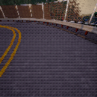
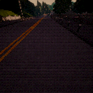
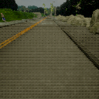
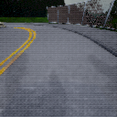
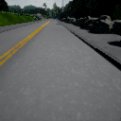
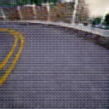
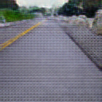
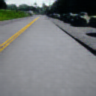
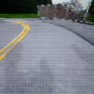
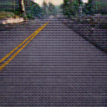
Recap
Original
Image
Guide Image

Slide 3
What we did
retrain with full and extended dataset (10 classes with 17000 images in each training folder)
before was 5 classes with 10 images per training folder
trained longer, 100.000 iterations vs. 40.000 iterations

Slide 4
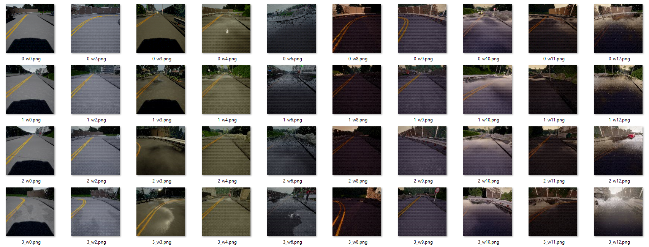
The Dataset

Slide 5
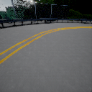
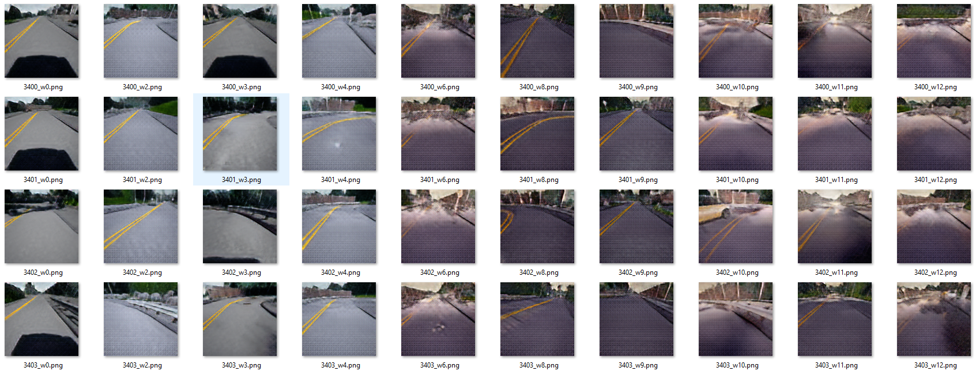
Results w0
Original
source
Guide
Image

Slide 6
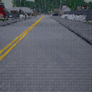
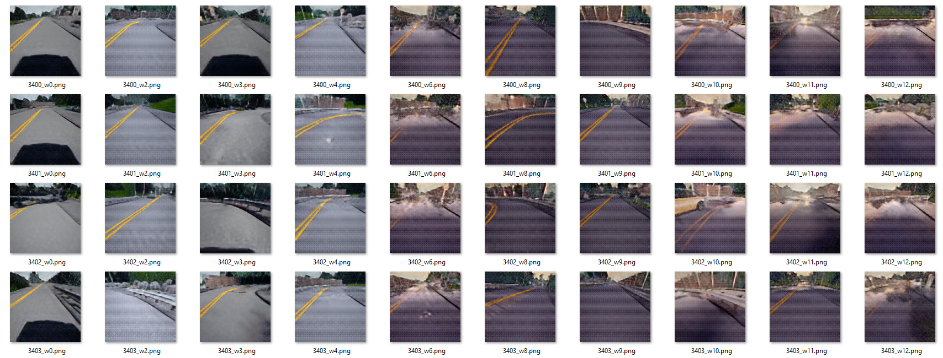
Results w2
Original
source
Guide
Image

Slide 7
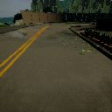
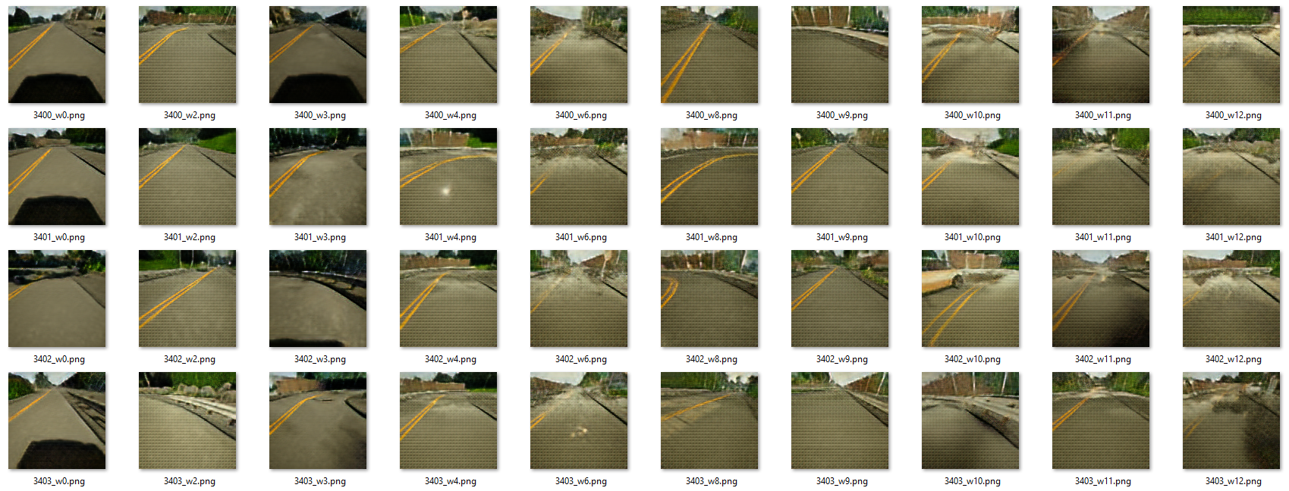
Results w3 (rainy)
Original
source
Guide
Image

Slide 8
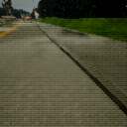
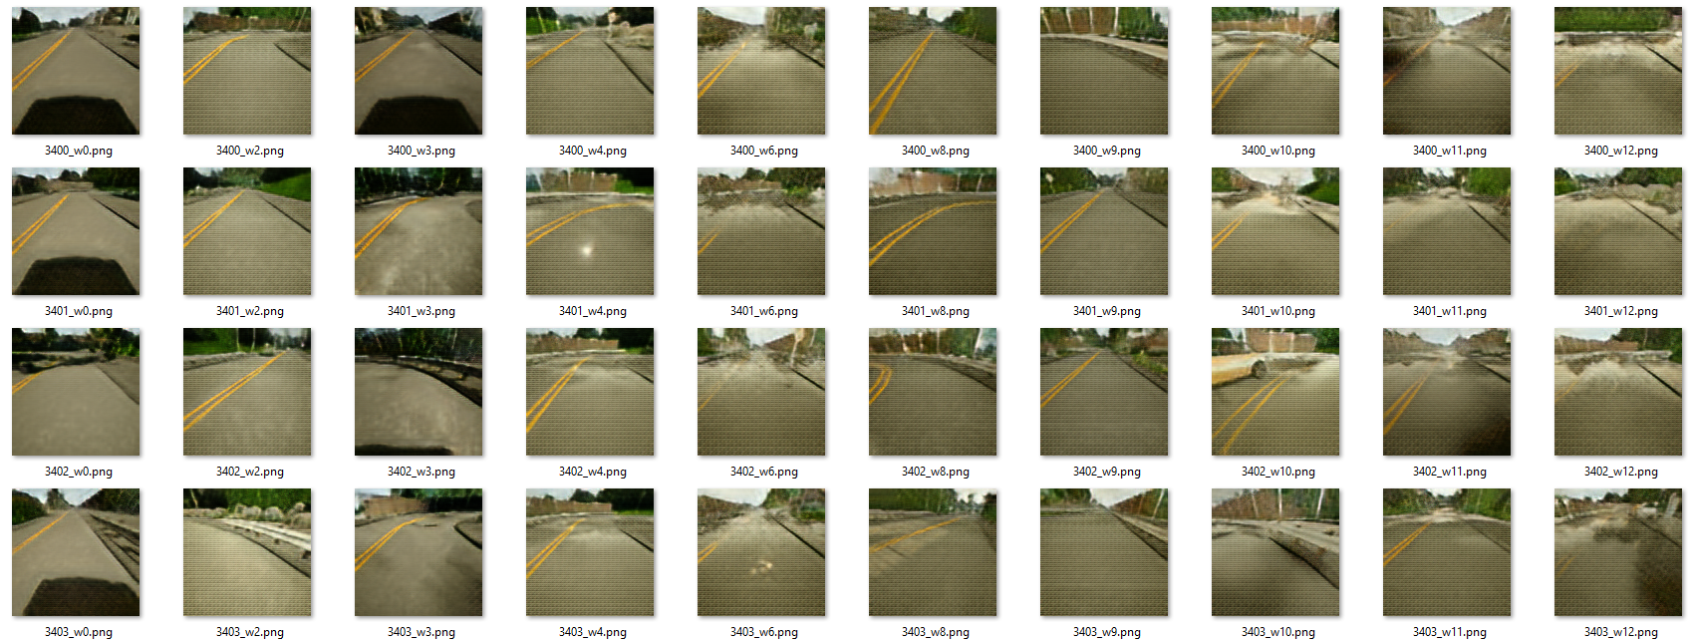
Results w4
Original
source
Guide
Image

Slide 9
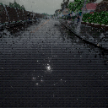
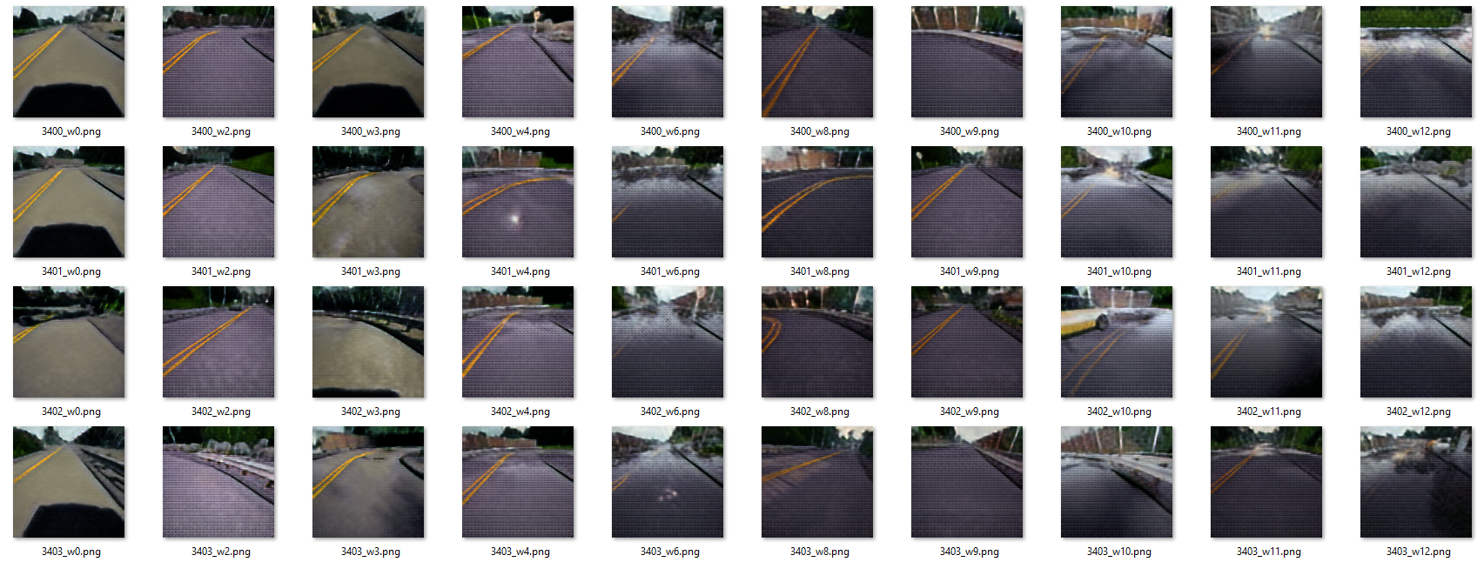
Results w6
Original
source
Guide
Image

Slide 10
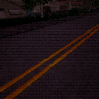
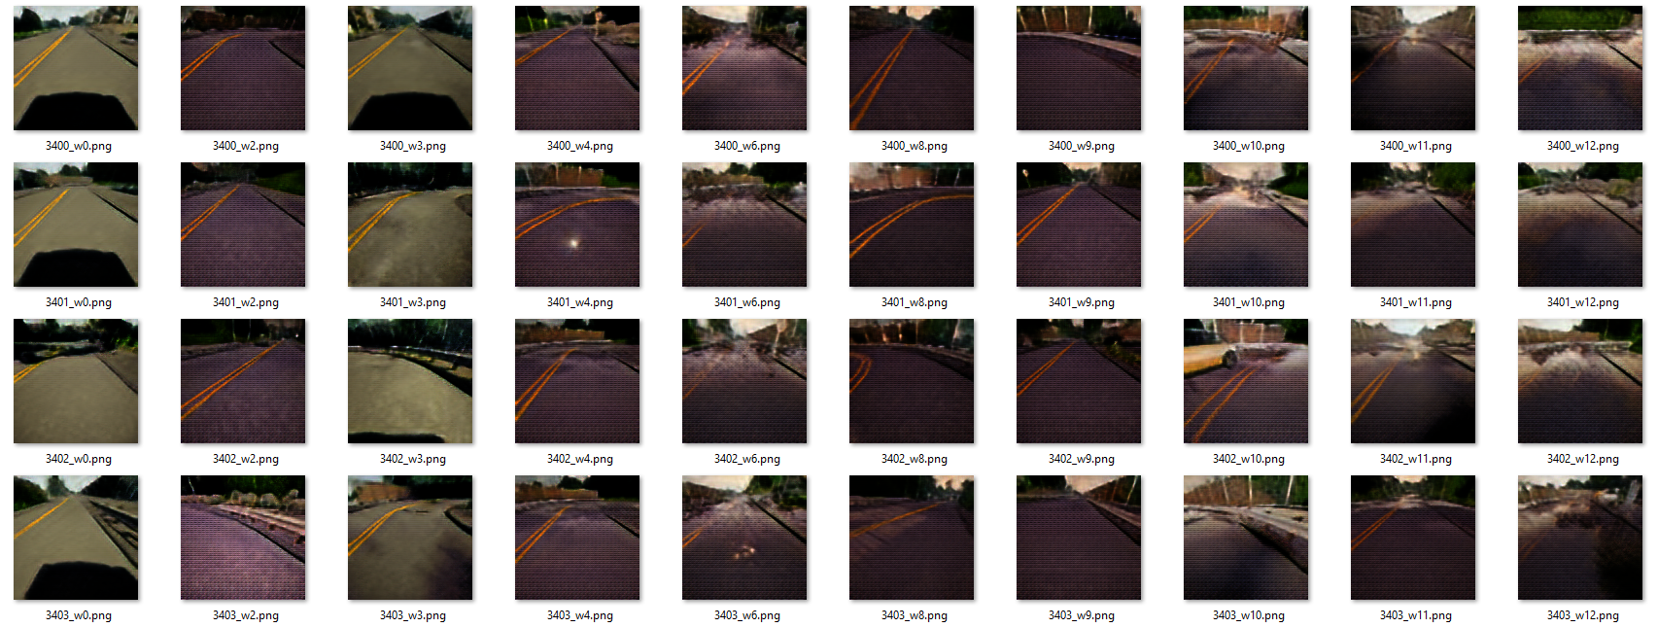
Results w8
Original
source
Guide
Image

Slide 11
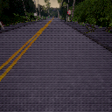
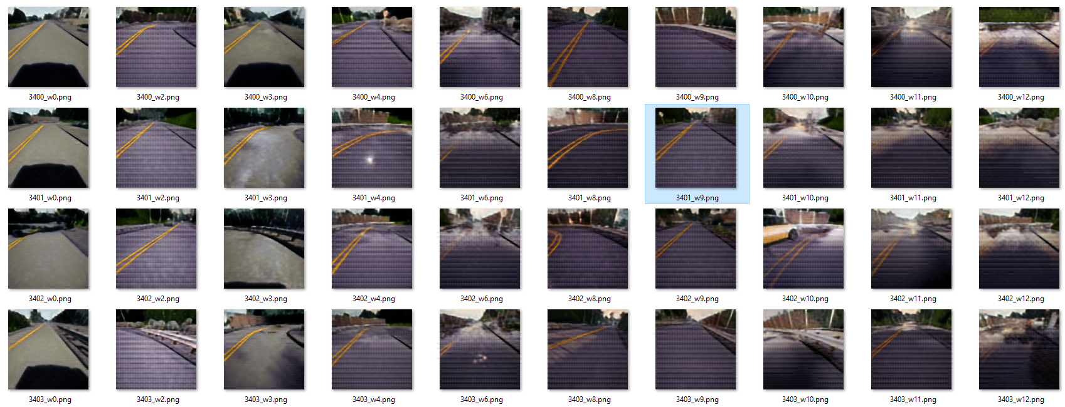
Results w9
Original
source
Guide
Image

Slide 12
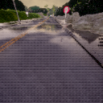
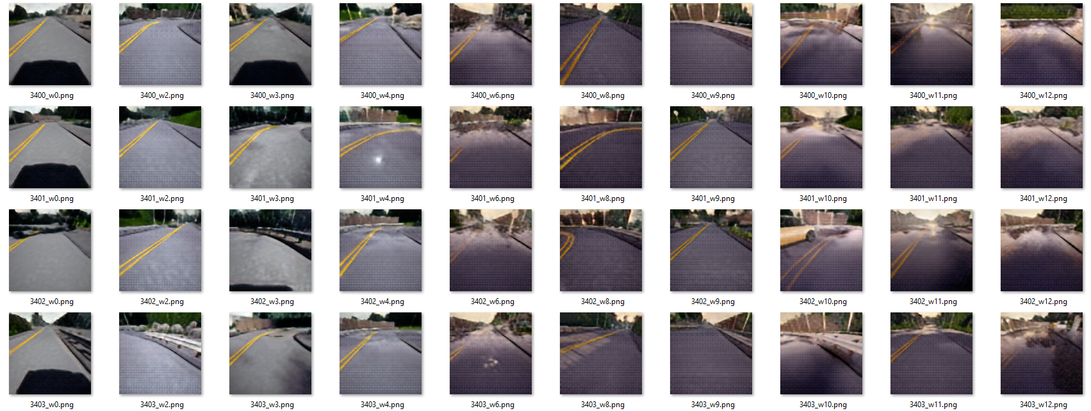
Results w10
Original
source
Guide
Image

Slide 13
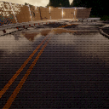
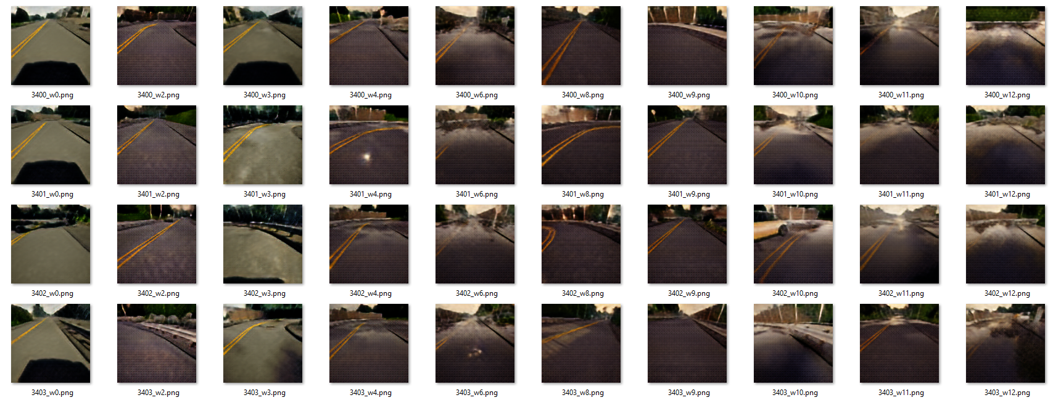
Results w11
Original
source
Guide
Image

Slide 14
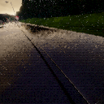
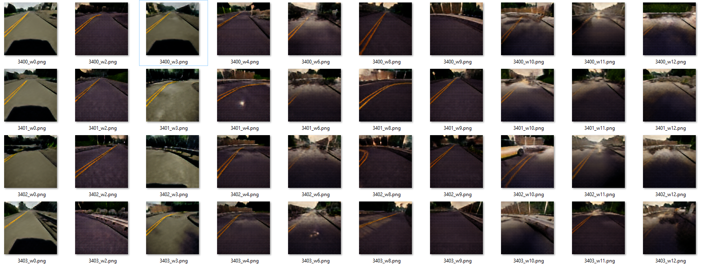
Results w12
Original
source
Guide
Image

Slide 15
Results - Conclusion
The translation has mixed results:
Translation to the green images (w3 & w4) works well with the colors, but w3 and w4 are almost indistinguishable (difference in smoothness of picture and rain)
Translation of the smooth pictures (w0 & w3) barely ever works
Translation from bright image into a dark image works better than the other way round (e.g. w2->w8 works well, but w8->w2 doesn’t)
The network thinks w10 and w0&w2 are almost the same

Slide 16
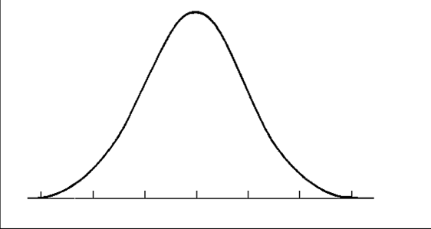
MUNIT – Recap on how we train
weathers
weather A
weather B
mode at
weather A
mode at
weather B
Style Code A
Style Code B
conditioning A
conditioning B
Input
Input
Dataset X1 and X2 are all images from all weather conditions

Slide 17
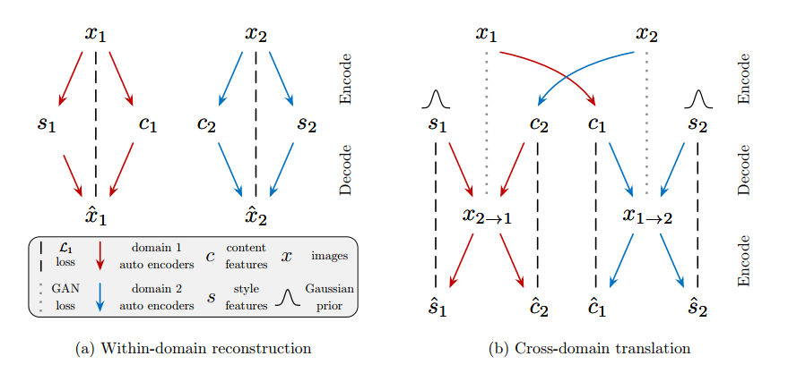
MUNIT - Hypothesis
First of all, a recap on how we train, in our case, x1 and x2 are all images from all weather conditions.
The discriminator only distinguishes between real/fake image of the domain. It can be any image of the domain (i.e. any weather condition).
So the constraint of the GAN loss is too weak to generate images from the desired weather condition.
We have to make a “categorical loss” to ensure, the fake image is from the right weather condition.

Slide 18
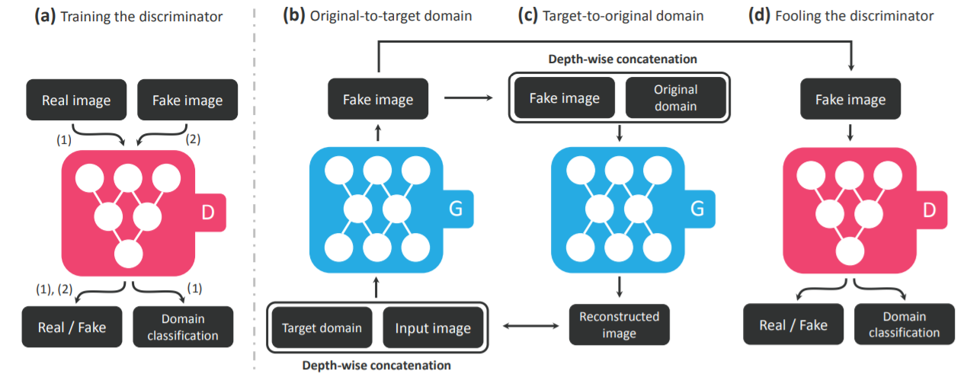
To do
Therefore, MUNIT seems to be a dead end
We found another network StarGAN, and will try that out

